Slide 1

Blocksys 2020
Exploring EOSIO via Graph Characterization
Yijing Zhao, Jieli Liu, Qing Han, Weilin Zheng,Jiajing Wu
Notes:
Good morning everyone. I am Yijing Zhao from Sun Yat-sen University.
The title of my presentation is:
Exploring EOSIO via Graph Characterization

Slide 2
Outline
Background
Motivation
Data Collection
Graph Analysis
Conclusion
Notes:
My talk includes five parts.
The first part is background.

Slide 3

Background
EOSIO
Outstanding performance
Large transaction information in blocks
Several activities: account vote, money transfer, accounts creation and contract authorization etc.
Notes:
Recent years, blockchain technology has become a buzzword and has aroused a great deal of interests among researchers. However, previous systems like Etherum suffer from some problems and unable to meet the demand of the rapid development of decentralized applications (DApps). A new platform EOSIO provides a solution for these problems. Built for commercial DApps, EOSIO has some outstanding features like free for usage, high throughput and eco-friendly, having attracted much attention. Especially, the number of transactions in EOSIO has reached more than four billion within two years, which witnesses the prosperity of EOSIO.
Like other blockchain systems, EOSIO can store its transaction information in blocks, which apply the foundation of our research on EOSIO.
There are Several activities like account vote, money transfer, accounts creation and contract authorization etc on EOSIO, which makes this system more interesting and harder to understand.

Slide 4
Outline
Background
Motivation
Data Collection
Graph Analysis
Conclusion
Notes:
In the next section, I will introduce our motivation.

Slide 5
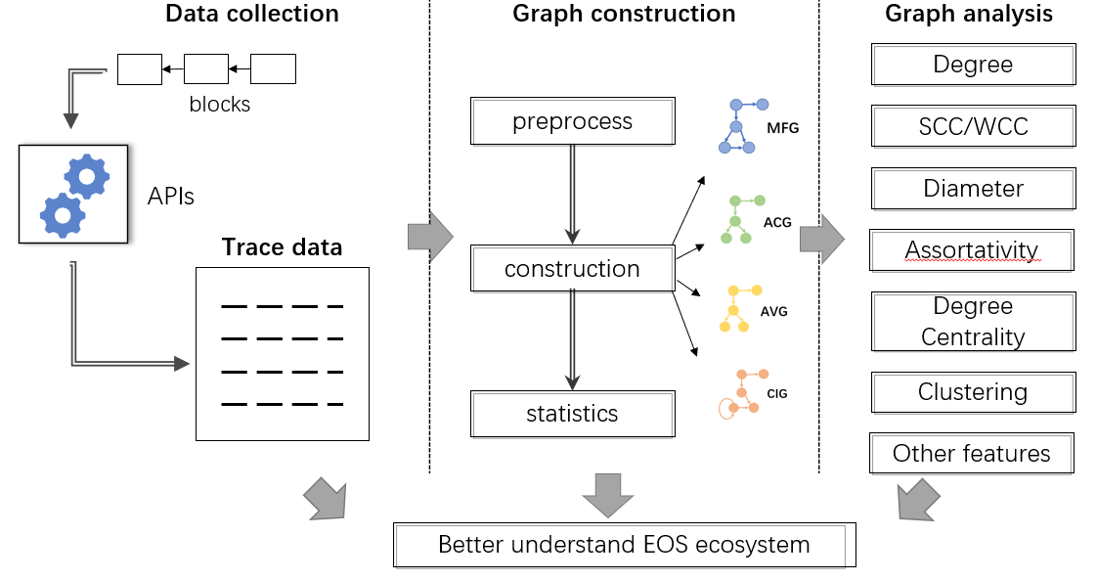
Motivation
Graph Analysis on Blockchain Transaction Data
Conduct data mining tasks on graph-structure data
Describe the graph properties via some metrics
Notes:
Up to now, many researchers have conducted graph analysis on blockchain transaction data. Existing work on blockchain transaction graph analysis can be divided into describing the graph properties via some metrics, and conducting data mining tasks on graph-structure data. And our work focuses on the former one. Many researches analyze graph properties of Bitcoin and other system. But EOSIO is a newly emerging blockchain system so the works about it are few.
We collect transaction data and conduct graphs according to activities on EOSIO. By investigating several graph metrics, We obtain some interesting insights.

Slide 6
Outline
Background
Motivation
Data Collection
Graph Analysis
Conclusion
Notes:
Then, I will talk about our dataset and some feathers about them.

Slide 7
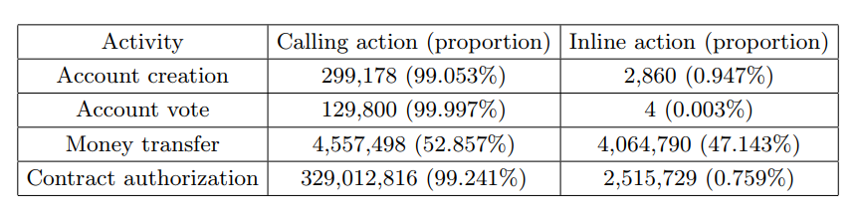
Data Collection
All transaction data of the first 15 million blocks, from the launch of EOSIO on June 6, 2018
Utilize Nodeos to synchronize the on-chain data
Replay all transactions and utilize the action trace data
The statistics of actions for the four activities is shown in the table
Notes:
Since the large volume of transaction data, it is infeasible to obtain all transaction data we need by directly crawling them from blockchain explorer. We first utilize Nodeos, an EOSIO client to synchronize the on-chain data. For inline transaction information which is not on-chain, we replay all transactions and utilize the action trace data.
The statistics of actions for the four activities is shown in the table. we can conclude that the voting behaviors are relatively transparent in the early EOSIO because most of them are accomplished with calling actions whose records are public accessible in blockchain. Though money transfer activity can be conducted by directly calling the interface provided by eosio.token through calling actions, the proportion of inline actions in money transfer activity is relatively high, which means smart contracts are widely used in setting specific transaction rules by users. For contract authorization, it also has a small proportion of inline actions, and this phenomenon is caused by the selfinvocation between contracts.

Slide 8
Outline
Background
Motivation
Data Collection
Graph Analysis
Conclusion
Notes:
In the next section, we will introduce our Graph Analysis.

Slide 9
Graph Analysis
Some Interesting Insights
In the early EOSIO, some accounts participate in transactions for testing or experiencing the platform.
Some risks exist in EOSIO, like the voting gangs in which the members vote for each other and the observing abnormal account for pressure testing.
EOSIO may exist spam transactions in its billions of transactions.
Notes:
By investigating several graph metrics, We obtain some interesting insights as follows:

Slide 10
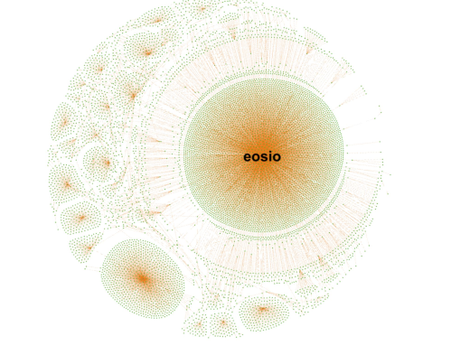
Graph Analysis
Account Creation Graph(ACG)
A directed graph G = (V, E)
V is the set of nodes :accounts in EOSIO
E is the set of edges (vi, vj), vi, vj∈V : account creation relationship that vi create vj
Degree Distribution
Notes:
We conduct Account Creation Graph as we showed on the powerpoint and its visualization is showed in figure. In this graph, the node number is one more than the edge number, which implies that each node except the initial system account eosio can be created once by its father account. Since a father account must be an existing account in EOSIO, the ACG is a tree-like graph with no circle.

Slide 11
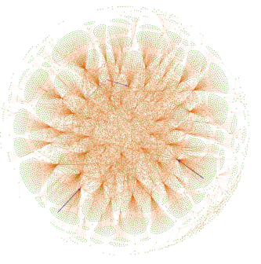
Graph Analysis
Account Vote Graph (AVG)
A directed weighted graph G = (V, E, W)
V denotes the set of nodes: accounts enrolling in EOSIO’s voting activity
E denotes the set of edges (vi, vj), vi, vj ∈ V : vi votes for vj
mapping function φ : E → W that maps a weight from the edge attribute set W for each edge: voting times between vi and vj .
Notes:
This figure displays the visualization result of AVG, where the thickness of each edge is proportional to its weight value. We observe that several edges are obviously thicker than others, which account for the continued supports to some candidates. There exist some hub nodes in the graph, representing some influential candidates. Besides, many edges are randomly distributed in AVG, which reflects that in the early EOSIO, some voters participate in voting for testing or experiencing.

Slide 12
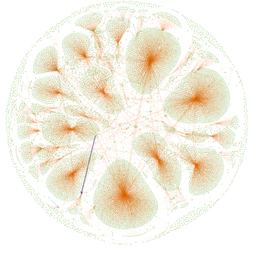
Graph Analysis
Money Transfer Graph (MTG)
A directed weighted graph G = (V, E, W)
V denotes the set of : accounts participating in transferring EOS
E denotes the set of edges (vi, vj, w),
vi, vj ∈ V, w ∈ W : vi totally transfers
w EOS to vj
function φ : E → W that maps a weight from the edge attribute set W for each edge
Degree Distribution
Notes:
We visualize MTG, and make the thickness of each edge be proportional to its weight value. As shown in Fig. 5, the sampling subgraph of MTG exist significant community structures. It contains a few large-degree nodes, which are community centers and interact frequently with surrounding nodes, these nodes may be exchanges or accounts of some DApps in charge of their ledger. There are also a large number of small-degree nodes in MTG, the free for usage feature offers a low-barrier entry point for individual users

Slide 13
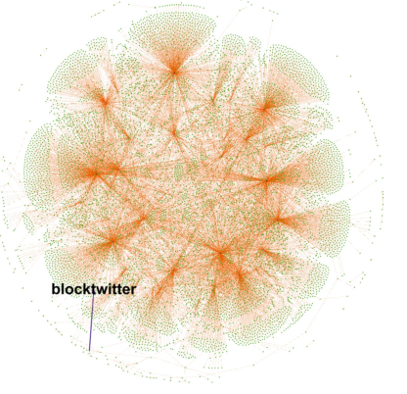
Graph Analysis
Contract Authorization Graph (CAG)
A directed graph G = (V, E)
V is the set of nodes:
accounts in EOSIO
E is the set of edges(vi, vj), vi, vj ∈V: account creation relationship that vi creates vj
Degree Distribution
Notes:
The visualization result is shown in Figure, where the thickness of each edge is proportional to its weight value. There exists some nodes with large degree in CAG, which may because some influential contracts (e.g. contracts of some popular DApps) are invoked by many accounts, or some active accounts invoke a large number of different contracts. Besides, an edge of \blocktwitter" is conspicuous in the graph with large thickness, in fact, “blocktwitter" is reported to be an abnormal account that would periodically launch a great many of actions named tweets for pressure testing, and it behaves like a contract for denial of service attack.

Slide 14
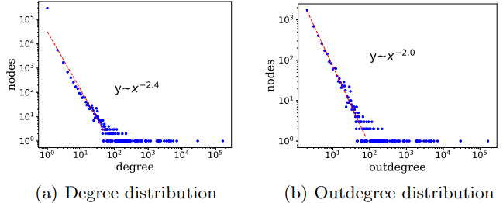
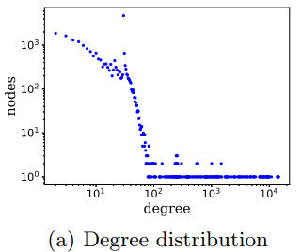
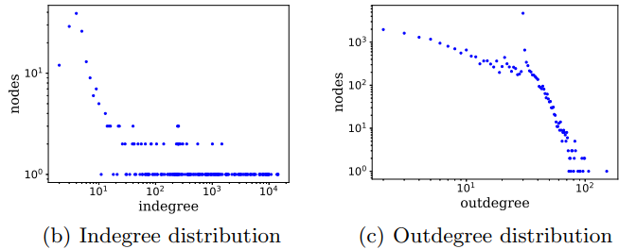
Graph Analysis
Degree Distributions
Account Creation Graph
Account Vote Graph
Notes:
We plot the degree distribution, indegree distribution and outdegree distribution of the four mentioned graphs. All of them satisfy the power law distribution, except for AVG.
The distributions of ACG indicate that there are a few accounts creating many accounts with large degree. Besides, since the initial system account eosio have no indegree, and the indegree of other accounts is 1 because they can only be created once, we do not present the indegree distribution of ACG.
For AVG, we can observe that candidates with a large number of supporters occupy a small proportion of all candidates. And the voting times for most voters are few, which may be related to the rule that voters should mortgage a part of EOS tokens when voting.

Slide 15
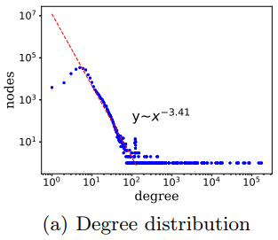
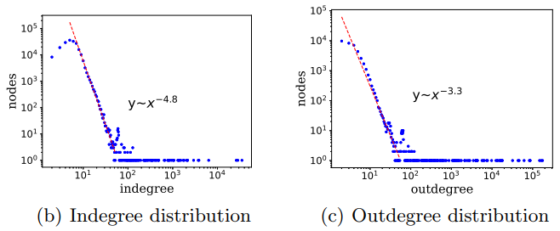
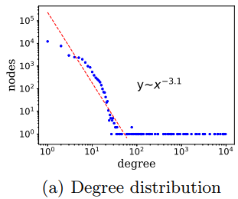
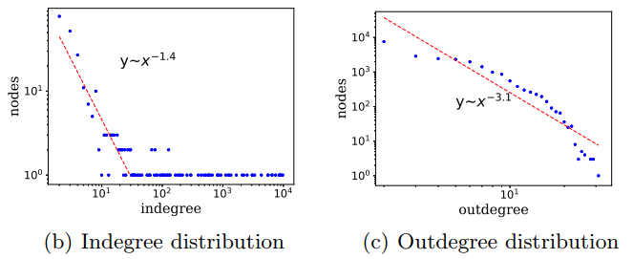
Graph Analysis
Degree Distributions
Money Transfer Graph
Contract Authorization Graph
Notes:
In MTG, there are a few accounts take part into money transfer activities for many times, most of the accounts are small-degree nodes. By investigating the fitting line, we can draw a conclusion that the distribution of outdegree is more variable than the distribution of degree and indegree, since the larger the power exponent, the more variable of the degree.
For the indegree distribution of CAG, we can know that few contracts have been invoked for many times. That is, not all contracts are widely known and invoked by users. For the outdegree distribution, few accounts delegate their permissions to others for many times. Besides, there exists no long tail in the outdegree distribution, and the outdegree gap is small, which means that many users in the early EOSIO only interact with a limited number of contracts. Of course, this phenomenon may also be related to the small number of smart contracts in the initial phase of EOSIO.

Slide 16
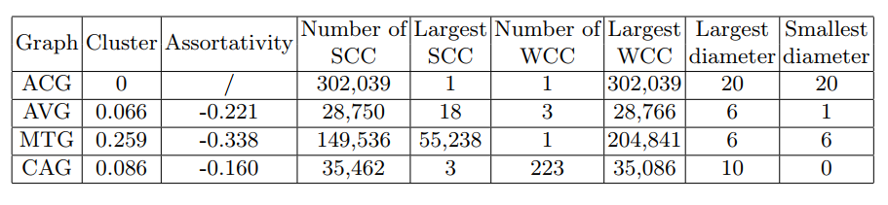
Graph Analysis
Account Creation Graph
√ No account creation relationship between two accounts created by the third node
√ Each account can only be created by an existing account
Metrics of Graphs
Notes:
The table shows some graph metric, including the values of the clustering coefficient, assortativity coefficient, number of SCC/WCC, and so on.
Some conclusions can be revealed by the data. For example, in ACG, the clustering coefficient is 0, because there is no account creation relationship between two accounts created by the third node. the number of nodes in the largest SCC is 1 and all nodes are in the largest WCC, which match the fact that each account can only be created by an existing account.

Slide 17
Graph Analysis
Account Vote Graph
√ few triangles
√ none of the candidates vote for themselves
√ Exist some voting gangs in which the members vote for each other
Metrics of Graphs
Notes:
For AVG, the clustering coefficient is 0.066, namely there are few triangles in AVG. If a voter votes for two candidates, these two candidates will barely vote for each other owing to their competitive relationship. The number of nodes in the largest SCC is 18, indicating that there exist some voting gangs in which the members vote for each other. Besides, none of the candidates vote for themselves, which is reflected by the smallest diameter.

Slide 18
Graph Analysis
Money Transfer Graph
√ Exist some hub nodes (e.g., system accounts, exchanges) or sham transactions
√ Small world
Contract Authorization Graph
√ there may exist some accounts belonging to the same owner (e.g., a DApp)
√ Some accounts invoke their own contract
Degree Distribution
Metrics of Graphs
Notes:
The number of nodes in the largest SCC accounts for about 26.97% of all the nodes in MTG., indicating that there exist some hub nodes (e.g., system accounts, exchanges) or sham transactions that could cause large SCC in MTG. The diameter of MTG is small and the clustering coefficient is large, indicating a small world phenomenon in MTG.
In CAG, the number of nodes in the largest SCC is 3, which implies that there may exist some accounts belonging to the same owner (e.g., a DApp), and their contracts collaborate closely to complete some specific functions. More than 98.89% nodes are contained in the largest WCC. The smallest diameter of WCC is 0 since some accounts invoke their own contract.

Slide 19
Outline
Background
Motivation
Data Collection
Graph Analysis
Conclusion

Slide 20
Conclusion
Our contribution
The first systematic and comprehensive research on the early EOSIO via analyzing four major activities, namely account creation, account vote, money transfer and contract authorization
Construct four graphs for the four major activities in EOSIO, by measuring some graph
Observe some abnormal phenomenons like voting gangs and sham transactions in EOSIO during our analysis
Future work
Observe abnormal behaviors on EOSIO
Provide constructive suggestions for EOSIO supervision
Notes:
To sum up, in this work, we investigate the four major behaviors in EOSIO by conducting a graph analysis. Our major contributions are listed as follows:
In the future, we will experiment on other datasets , and further analyze the properties of the critical nodes obtained by our strategy.

Slide 21
Thank You!
Q & A
Notes:
That’s all, thank you.

